Slide 1
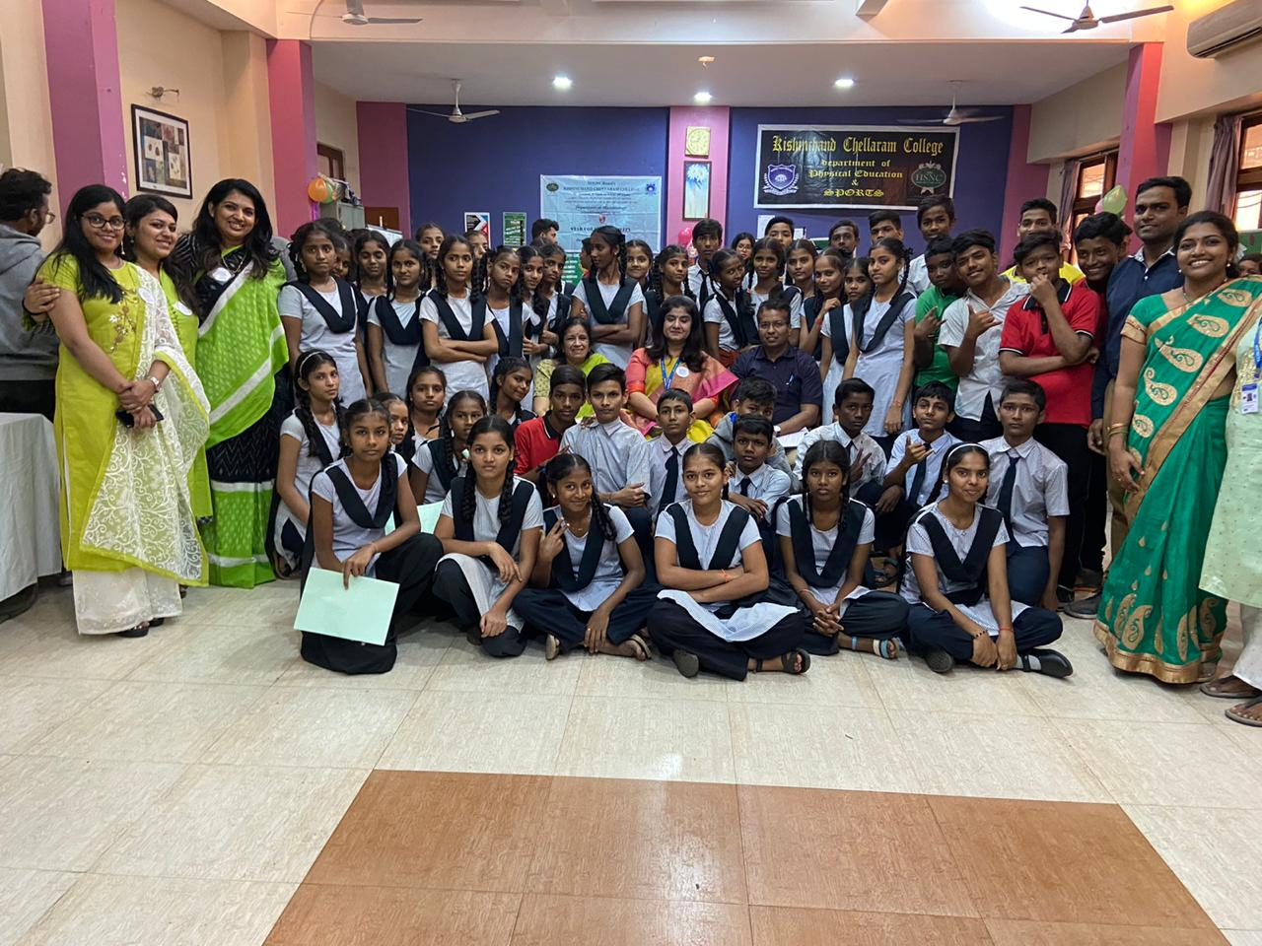
Microfiesta4.0 (2019-20)
Principal Dr. Hemlata K. Bagla, Dr. Sahayog Jamdhar and Mrs. Prabha Padmanabha along with the department teachers and school students

Slide 2
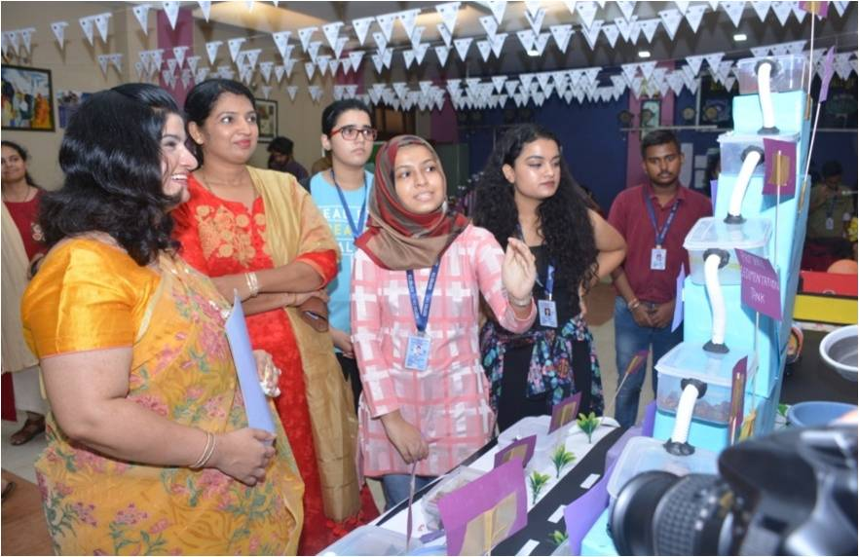
Microfiesta.3 (2018-19)
pics
Students explaining their model to Principal Dr Hemlata K. Bagla at Microfiesta.3.0

Slide 3
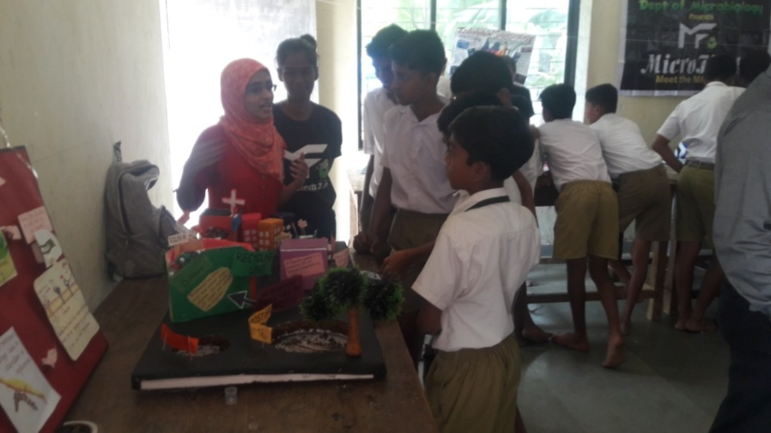
Microfiesta.2 (2017-18)
Scientific models being explained to school students at Saphale

Slide 4
Microfiesta.2 (2017-18)
School Students observing various types of Microbes

Slide 5
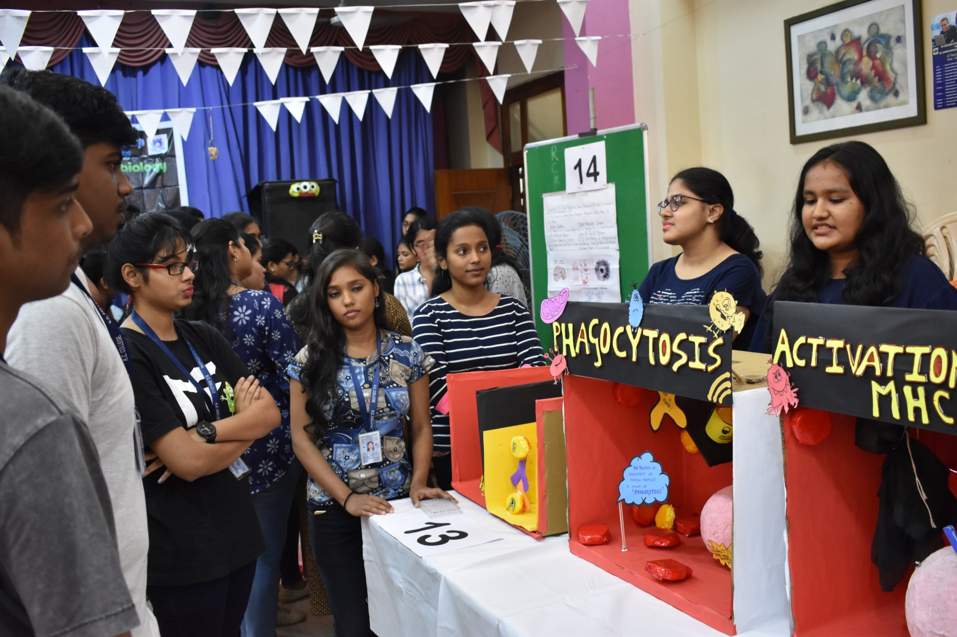
Microfiesta.3 (2018-19)
Students explaining concepts to Undergraduate and Junior college students

Slide 6
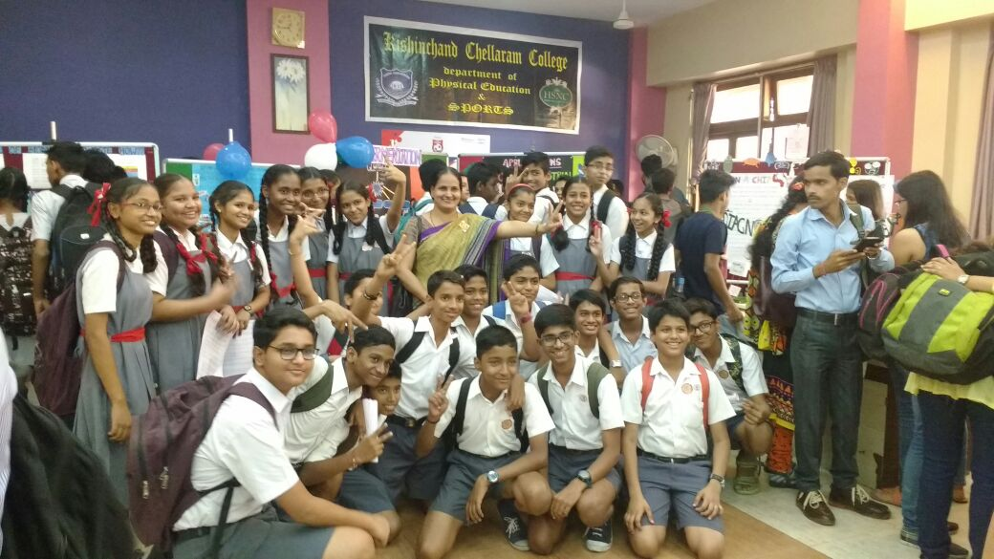
Microfiesta. (2016-17)
School students attending Microfiesta

